Slide 1
What is Robotics?
Robotics is the intersection of science, engineering and technology that produces machines, called robots, that substitute for (or replicate) human actions.
A robot is the product of the robotics field, where programmable machines are built that can assist humans or mimic human actions.
Robots were originally built to handle monotonous tasks (like building cars on an assembly line), but have since expanded well beyond their initial uses to perform tasks like fighting fires, cleaning homes and assisting with incredibly intricate surgeries.
Each robot has a differing level of autonomy, ranging from human-controlled bots that carry out tasks that a human has full control over to fully-autonomous bots that perform tasks without any external influences.

Slide 2
Definition
Origin of the word robot in 1923 from Czech word ‘robota’ meaning slave labour!
Designed to replace human beings, and depicted as very efficient and lacking emotion – Even now this description is prevalent!
No clear definition of a “robot”!.
The Robot Institute of America (1969) defines robot as “.... a re-programmable, multi-functional manipulator designed to move materials, parts, tools or specialized devices through various programmed motions for the performance of a variety of tasks”.

Slide 3
Definition
Currently the term “robots” are used more broadly as an “intelligent agent, physical or virtual, capable of doing a task autonomously or with guidance”.
Robot – An electro-mechanical machine with sensors, electronics and guided by computers.
Key concept is re-programmable and the extent of programming —Distinguishes a robot from CNC machine tools.

Slide 4
Introduction
Advances in robotics has closely followed the explosive development of computers and electronics.
Devol used his patent on magnetic recording devices for the “brains” of his Unimate.
First computer, ENIAC, was developed at University of Pennsylvania in 1946 and the first transistor device was built by Shockley and Pearson in Bell Labs in late 1940’s.
Another key ingredient, concept of feedback control — First textbook on feedback control is by Prof. Norbert Wiener of MIT in 1948.
Feedback allows execution of a programmed (desired) motion by a robot (and a large number of devices) with the required accuracy.

Slide 5
Introduction
Initial robot usage was primarily in industrial application such as part/material handling, welding and painting and few in handling of hazardous material.
Most initial robots operated in teach-playback mode, and replaced ‘repetitive tasks’.
Growth and usage of robots slowed significantly in late 1980’s and early 1990’s due to “lack of intelligence” and “ability to adapt” to changing environment – Robots were essentially blind, deaf and dumb!

Slide 6
Introduction
Last 25 years or so, sophisticated sensors and programming allow robots to act much more intelligently, autonomously and react to changes in environments faster.
Present-day robots :
Used in cluttered workspaces in homes and factories,
Interact safely with humans in close proximity,
Operate autonomously in hazardous environments,
Used in entertainment and in improving quality of life.

Slide 7
Types and Classification of Robots
Robots are broadly classified as:
Industrial Robots
Non-industrial or Special Purpose Robots
Industrial robots are intended to serve as general-purpose, unskilled or semiskilled labor, e.g. for welding, painting, machining etc.
A special –purpose robot is the one that is used in places other than typical factory environment. For example , a serial robot mounted on a spacecraft used for retrieval of a faulty satellite or putting it back after repair.

Slide 8
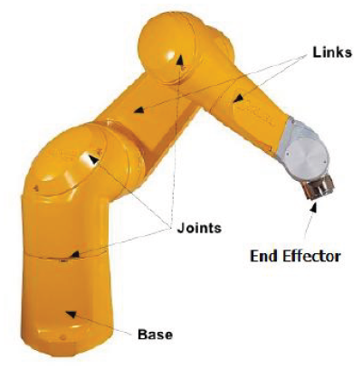
Types of Robot
Various ways of classifying a robot:
Fixed or Mobile.
Serial or Parallel.
According to degree of freedom (DOF).
Rigid or Flexible.
Control — Point-to-point, autonomy and “intelligence”.
Most older industrial robots — Fixed base and consisting of links connected by actuated joints.
Many modern robots can move on factory floors, uneven terrains or even walk, swim and fly!

Slide 9
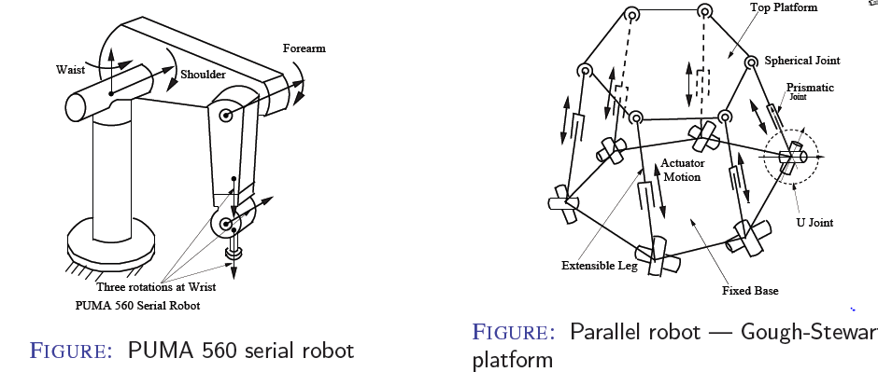
Serial Vs Parallel Robots
Serial Robot — A fixed base, links and joints connected sequentially and ending in a end-effector.
Parallel Robot — More than one loop, no natural end-effector.

Slide 10
Degree of Freedom (DOF)
It is defined as minimum number of independent Parameters/variables/coordinates needed to describe a system completely.
Example :
A point in 2-D : 2 dof ; in 3-D : 3 dof
A rigid body in 3- D : 6 dof
Spatial Manipulator : 6 dof
Planar Manipulator : 3 dof

Slide 11
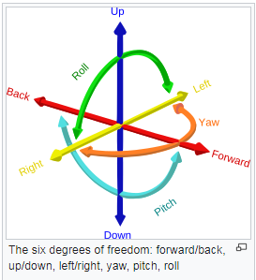
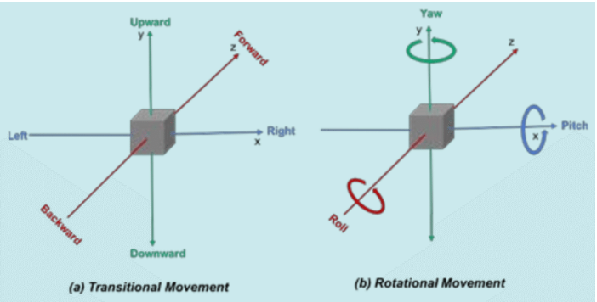
6- Degree of Freedom

Slide 12
Degree of Freedom (DOF)
It indicates the number of rigid (bodies) that can be connected to a fixed rigid body through the said joint.
Degree of freedom (DOF) determines capability of a robot and number of actuated joints.
Joints with one degree of freedom (DOF)
– Revolute Joint (R)
– Prismatic Joint (P)

Slide 13
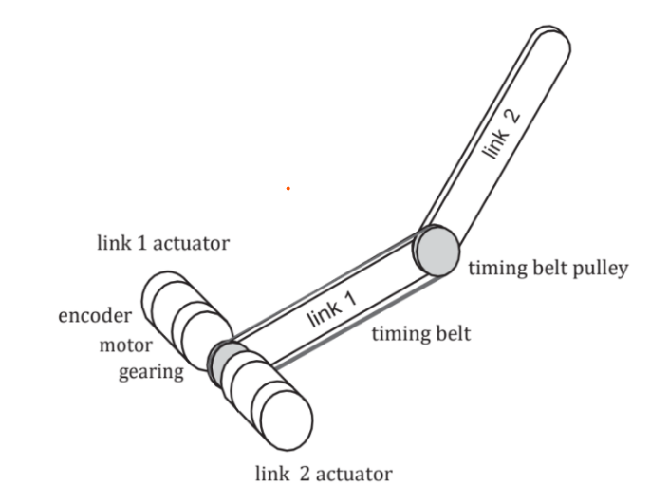
Revolute Joint (R)

Slide 14
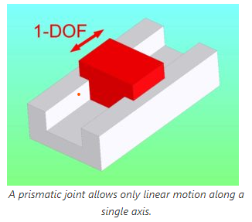
Prismatic Joint (P)

Slide 15
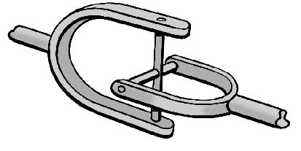
2 DOF – Universal Joint

Slide 16
6 (DOF) required for arbitrary task in 3D.
Painting and welding can be done by 5 DOF robot.
Electronics assembly usually done by 4 DOF SCARA robot.
For extra flexibility/working volume, 5 or 6 DOF robot mounted on 2 or 3 DOF gantry or wheeled mobile robot.
Redundant robot with more than 6 DOF for avoiding obstacles, more flexibility etc.

Slide 17
Arrangement of first three joints (in fixed serial robots) are classified as: Cartesian, spherical and cylindrical — Motion described by Cartesian, spherical or cylindrical coordinates.
Anthropomorphic — Human arm like.
SCARA or Selective Compliance Adaptive Robot Arm — Extensively used in electronic assembly.
Last three joints form a wrist — Orients the end-effector.

Slide 18
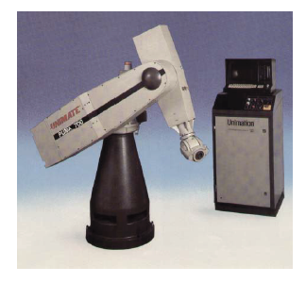
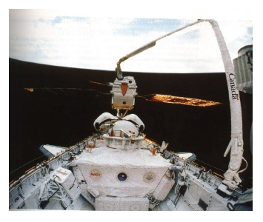
Rigid Vs. Flexible
PUMA 700 Series Industrial Robot
Space Shuttle Robot Arm
Most industrial robots are built heavy and rigid for required accuracy.
Minimizing weight for space applications — Links and joints are flexible!

Slide 19
Control and Mode of Operation
Most older industrial robots were teach and playback :
Robot is taken (manually) through the tasks and positions recorded.
During actual operation, the robot plays back the taught sequence.
Very time consuming to teach and robot cannot react to any changes in the environment.
Computer controlled — Inputs are given from a computer often after being tried out in an off-line programming system.
Sensor driven — Sensors are used to avoid obstacles and take decisions.
Intelligent — Robot can ‘learn’ about the environment using artificial intelligence (AI) and perform efficiently.

Slide 20
Main components of a robot
Robots are built to present solutions to a variety of needs and fulfill several different purposes, and therefore, require a variety of specialized components to complete these tasks.
Generally speaking, robotics components fall into these five categories:
Sensors
Control System
Actuators
Power Supply
End Effectors

Slide 21
Sensors
Sensors are devices that make robot feel the world as we human do with the help of our five sensors.
Sensors provide a robot with stimuli in the form of electrical signals that are processed by the controller and allow the robot to interact with the outside world.
Common sensors found within robots include video cameras that function as eyes, photo resistors that react to light and microphones that operate like ears.
These sensors allow the robot to capture its surroundings and process the most logical conclusion based on the current moment and allows the controller to relay commands to the additional components.

Slide 22
Control System
Control system is the brain of robot which takes inputs from sensors or other medium and take decision on the task to be performed.
Computation includes all of the components that make up a robot’s central processing unit, often referred to as its control system.
Control systems are programmed to tell a robot how to utilize its specific components, similar in some ways to how the human brain sends signals throughout the body, in order to complete a specific task.
These robotic tasks could comprise anything from minimally invasive surgery to assembly line packing.

Slide 23
Control System
A control system is a system that is designed to produce a specified output by the action of required controlling.
Now the controlling provided to the system can be either output independent or output dependent.
This variation leads to give two different categories of control system.
Open – Loop Control System
Closed – Loop Control System

Slide 24
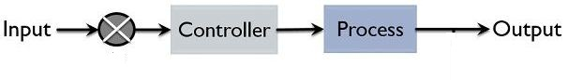
Open -Loop Control System
Systems in which the output quantity has no effect upon the input to the control process are called open-loop control systems.
Open-loop systems are just that, open ended non-feedback systems.

Slide 25
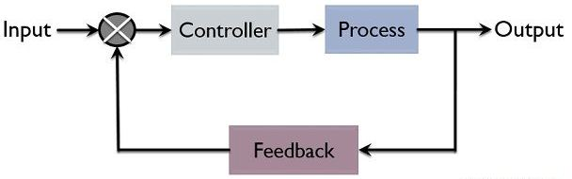
Closed -Loop Control System
A Closed-loop Control System, also known as a feedback control system is a control system which uses the concept of an open loop system as its forward path but has one or more feedback loops (hence its name) or paths between its output and its input.
The reference to “feedback”, simply means that some portion of the output is returned “back” to the input to form part of the systems excitation.

Slide 26
Actuators
Actuators are required to move joints, provide power and do work.
Serial robot actuators must be of low weight – Actuators of distal links need to be moved by actuators near the base.
Parallel robots – Often actuators are at the base.
Actuators drive a joint through a transmission device
Three commonly used types of actuators:
Hydraulic
Pneumatic
Electric motors

Slide 27
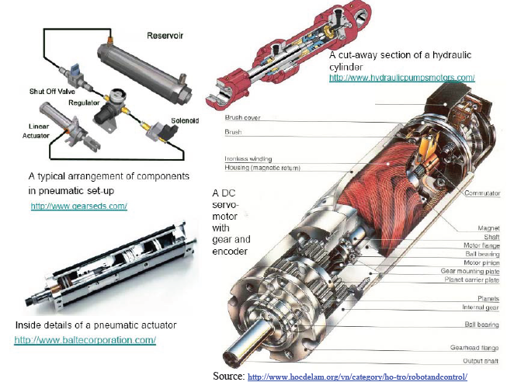

Slide 28
Power Supply
Like the human body requires food in order to function, robots require power.
Most robots utilize lead-acid batteries for their safe qualities and long shelf life while others may utilize the more compact but also more expensive silver-cadmium variety.
Safety, weight, replace ability and lifecycle are all important factors to consider when designing a robot’s power supply.

Slide 29
End Effectors
An end– effectors is a device attached to the wrist of a manipulator for the purpose of holding materials, parts, tools to perform a specific task.
End- Effectors
Grippers
End-effectors used to grasp and hold objects.
Tools
End-effectors designed to perform some specific tasks
Ex. Spot welding electrode, spray gun.

Slide 30
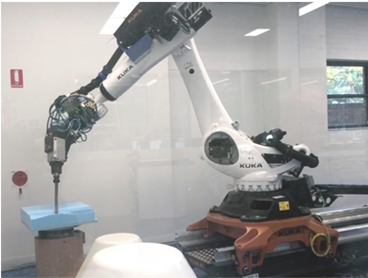
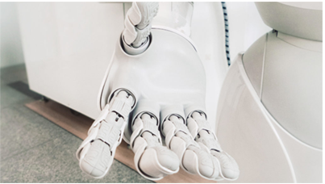
End- Effectors

Slide 31
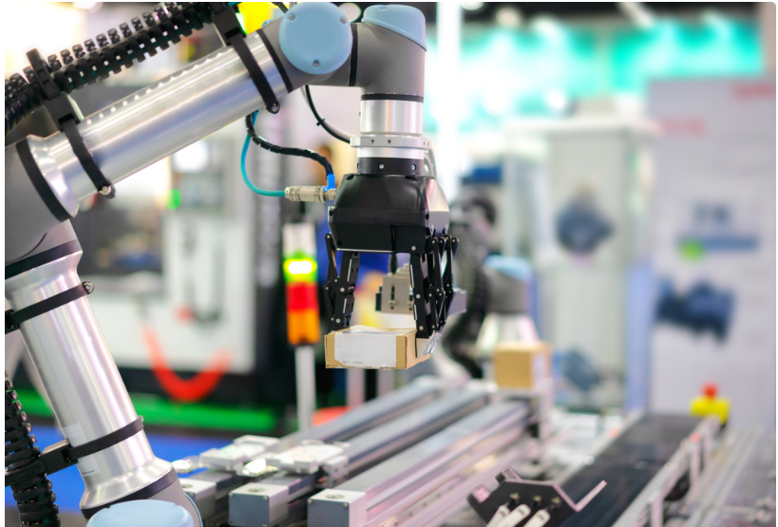
End- Effectors

Slide 32
Robotic Manipulator

Slide 33
Kinematics
Kinematics is a branch of physics and a subdivision of classical mechanics concerned with the geometrically possible motion of a body or system of bodies without consideration of the forces involved (i.e., causes and effects of the motions).
Motion of Robot arm without considering the forces and /or moments.
In kinematics we consider the relative motion of different joints and links but we generally do not try to find out the reason behind this particular relative moment.
Dynamics : Study of the forces and / or moments.

Slide 34
Robotic Manipulator
Robotic manipulator is a mechanical structure formed by links and joints so that they can control end- effector. It has a tool that allows manipulation operation.
The robotic manipulators are composed of:
Kinematic chain composed of Links and Joints.
The BASE: can be either fixed in the work environment or placed on a mobile platform.
End-Effector: Tool is located at the end, used to execute the desired operations [gripper or specic tool].

Slide 35
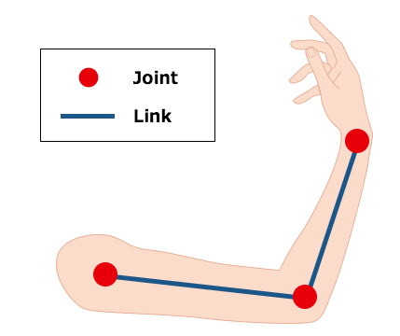

Slide 36
Robotic Manipulator

Slide 37
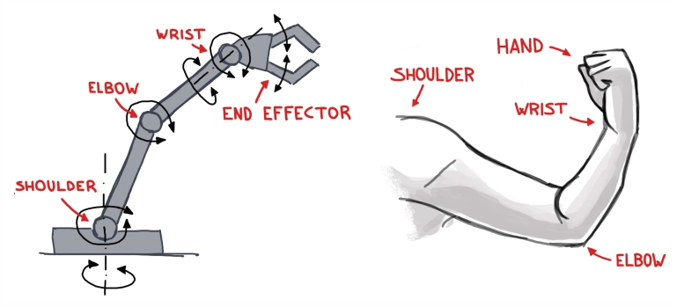
Robotic Manipulator

Slide 38
Joints
A joint connects two or more links.
A joint imposes constraints on the links it connects.
2 free rigid bodies have 6+6 degrees of freedom.
Hinge joint connecting two free rigid bodies ! 6+1 degrees of freedom.
Hinge joint imposes 5 constraints, i.e., hinge joint allows 1 relative (rotary) degree of freedom.
Degree of freedom of a joint in 3D space: 6 - m where m is the number of constraint imposed.
Serial manipulators ! All joints actuated ! One-degree-of-freedom joints used.
Parallel and hybrid manipulators ! Some joints passive !
Multi-degree-of-freedom joints can be used.

Slide 39
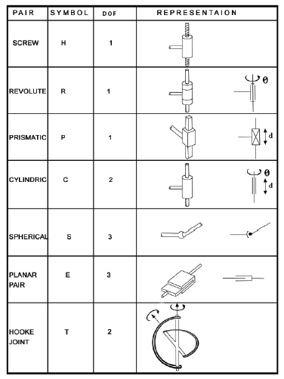
Types of Joints

Slide 40
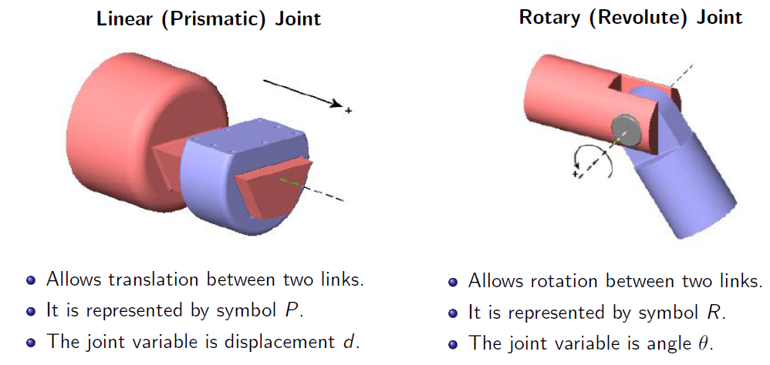
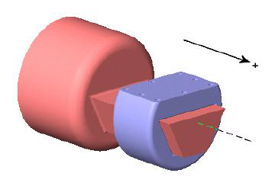
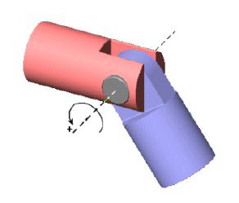
Types of Joints

Slide 41
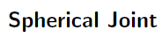
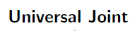
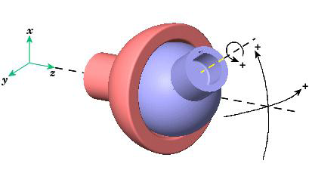
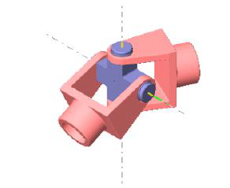
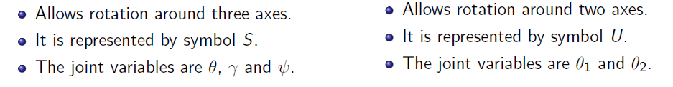
Types of Joints

Slide 42
Links
A link is a rigid body in 3D space – most robots are rigidly built.
A rigid body 3 D space has 6 degrees of freedom ! 3 rotation + 3 translation ! 6 parameters.
For links connected by rotary (R) and prismatic (P), possible to use 4 parameters – Denavit-Hartenberg (D-H)parameters (see Denavit & Hartenberg,1955).
4 parameters since lines related to rotary(R) and prismatic (P) joint axis are used.
For multi-degree-of-freedom joints ! Use equivalent number of one-degree-of-freedom joints.

Slide 43
MODELING AND ANALYSIS OF ROBOTS
New robots with improved capabilities made every day.
Technology changes but the underlying science/principles change more slowly.
Basic ingredients — Kinematics, dynamics, control, sensing and programming.
Kinematics — Motion of a object in three dimensional space without worrying about the cause.
6 degrees of freedom (DOF) — 3 translations and 3 rotations of a rigid link.
6 actuators at joints to achieve 6 DOF — Direct and Inverse kinematics problem.

Slide 44
Dynamics — Motion of links and end-effector due to the action of external forces/moments.
Obtain equations of motion by using Newton Laws or Lagrangian formulation.
Direct (or forward ) and inverse problem in dynamics for simulation and control.
Inverse problem solution required for advance control and design of manipulators
Required to be done efficiently – O(n) algorithms.

Slide 45
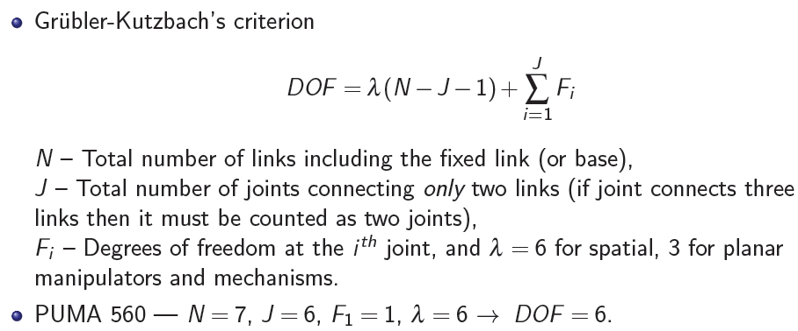
Degrees of Freedom (DOF)

Slide 46
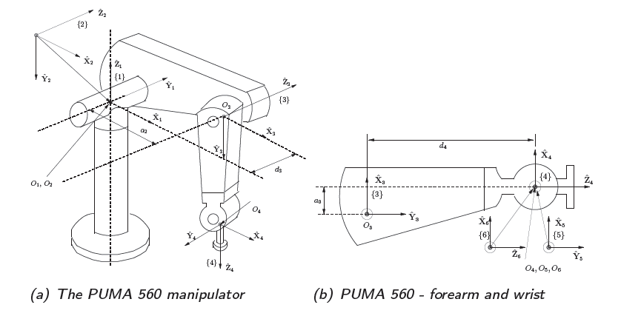
The PUMA 560 Manipulator

Slide 47
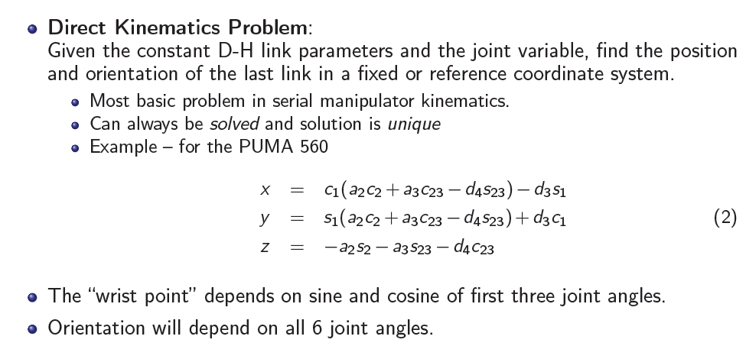
Kinematics Problems

Slide 48
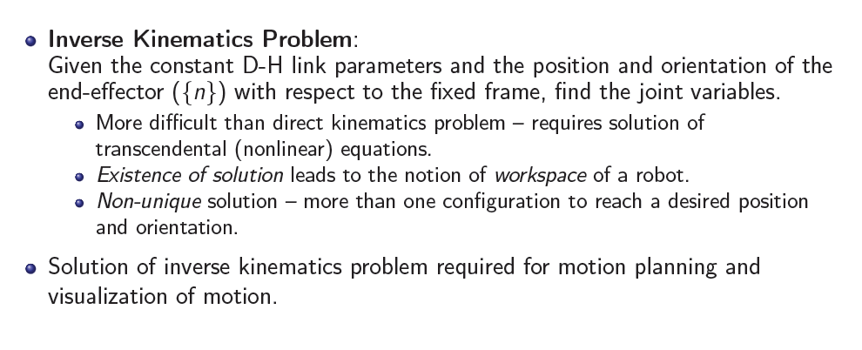
Kinematics Problems

Slide 49
Workspace

Slide 50
Workspace

Slide 52
Direct and Inverse Kinematics

Slide 53
Dynamics
Kinematics ! Cause of motion not considered.
Dynamics ! Motion of links of a robot due to external forces and/or moments.
Main assumption: All links are rigid – No deformation.
Motion of links described by ordinary differential equations (ODEs), also called equations of motion.
Several methods to derive the equations of motion – Newton-Euler, Lagrangian and Kane’s methods.

Slide 54
Dynamics
Newton-Euler – Obtain linear and angular velocities and accelerations of each link, free-body diagrams, and Newton’s law and Euler equations.
Lagrangian formulation – Obtain kinetic and potential energy of each link, obtain the scalar Lagrangian, and take partial and ordinary derivatives.
Kane’s formulation – Choose generalised coordinates and speeds, obtain generalised active and inertia forces, and equate the active and inertia forces.
Each formulation has its advantages and disadvantages.

Slide 55
Dynamics
Two main problems in robot dynamics:
Direct problem – Obtain motion of links given the applied external forces/moments.
Inverse problem – Obtain joint torques/forces required for a desired motion of links.
Direct problem involves solution of ODE’s -Simulation.
Inverse dynamics ! For sizing of actuators and other components, and for advanced model based control schemes.
Computational efficiency is of interest – seek O(N) or O(logN) .

Slide 56
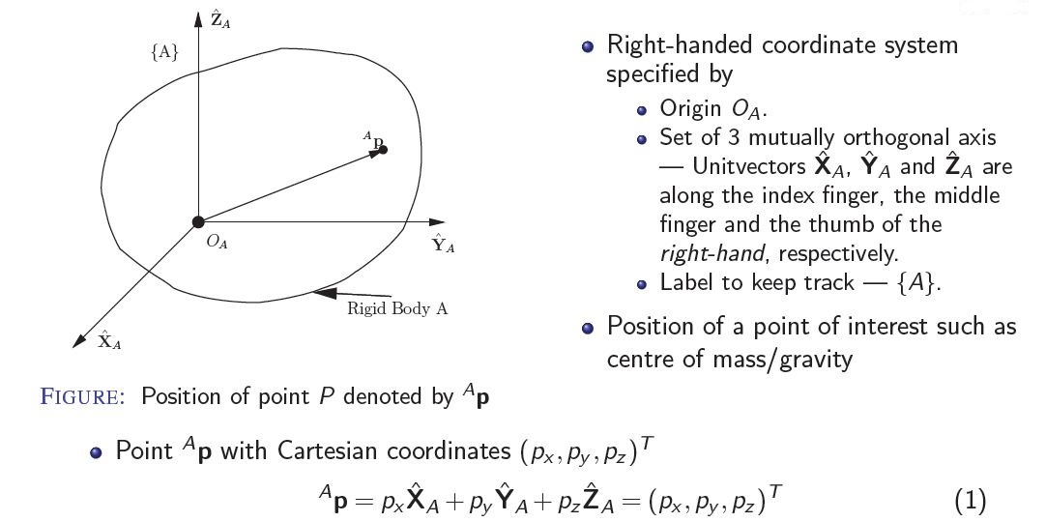
POSITION OF A RIGID BODY

Slide 57
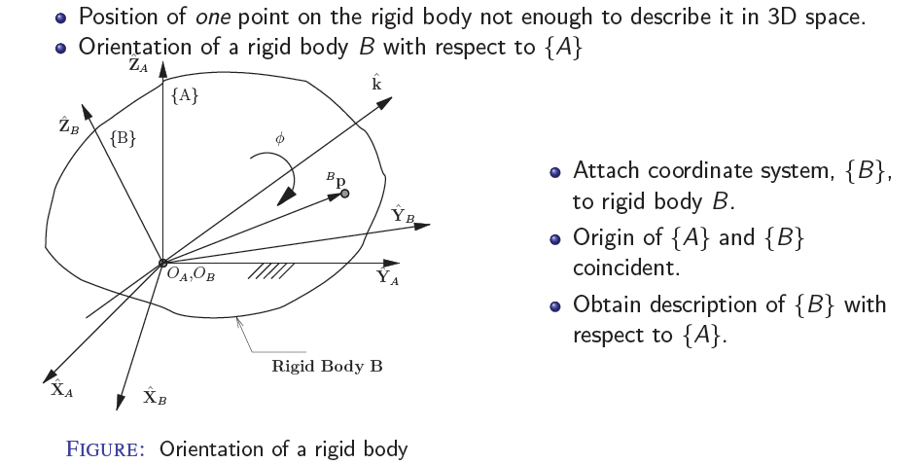
ORIENTATION OF A RIGID BODY

Slide 58
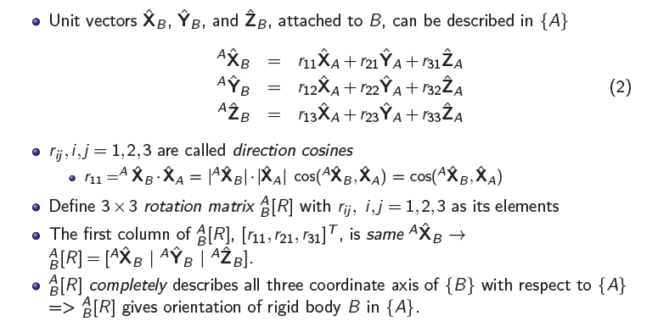
ORIENTATION – DIRECTION COSINES

Slide 59
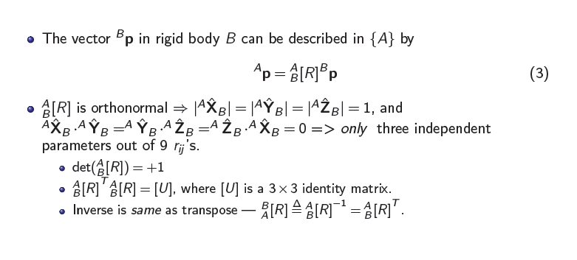
ORIENTATION – PROPERTIES OF ^{A}_{B}[R]

Slide 60
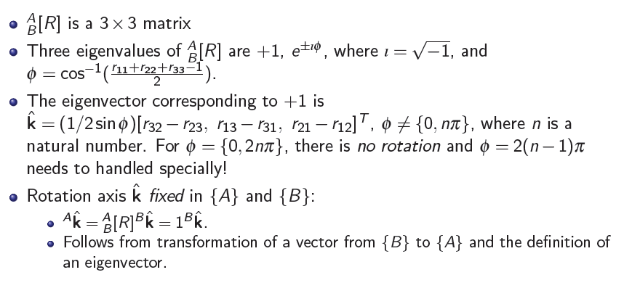
ORIENTATION – PROPERTIES OF ^{A}_{B}[R]

Slide 61
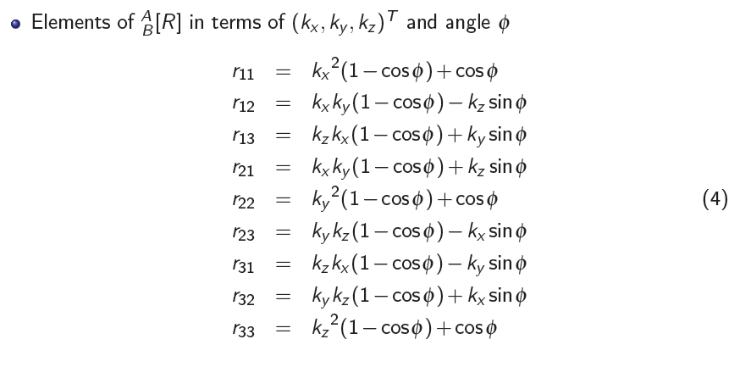
Orientation Using (k,ф)

Slide 62
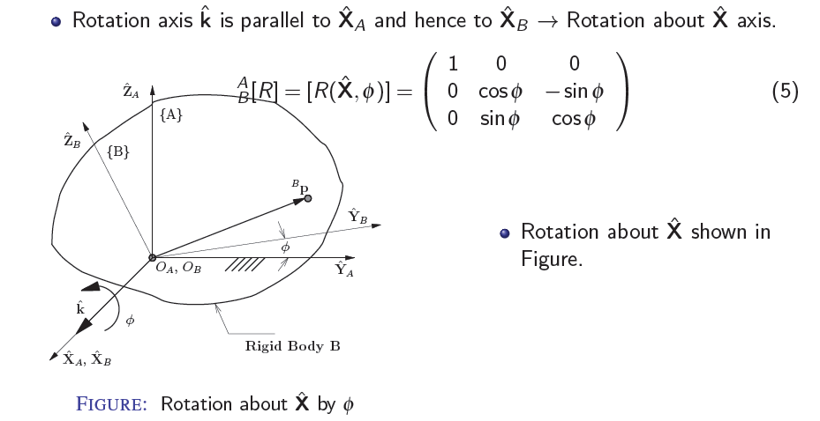
ORIENTATION – SIMPLE ROTATION

Slide 63
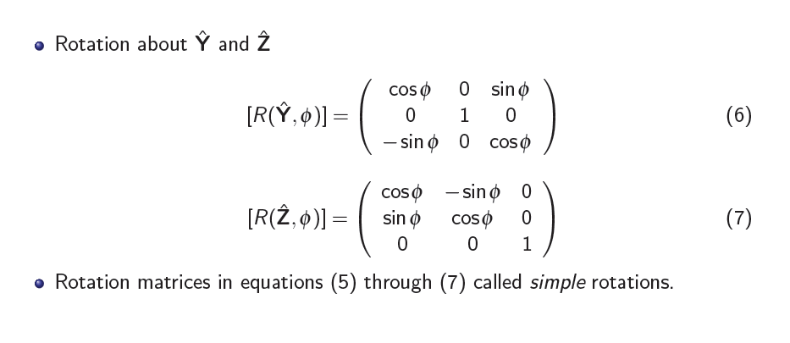
ORIENTATION – SIMPLE ROTATION

Slide 64
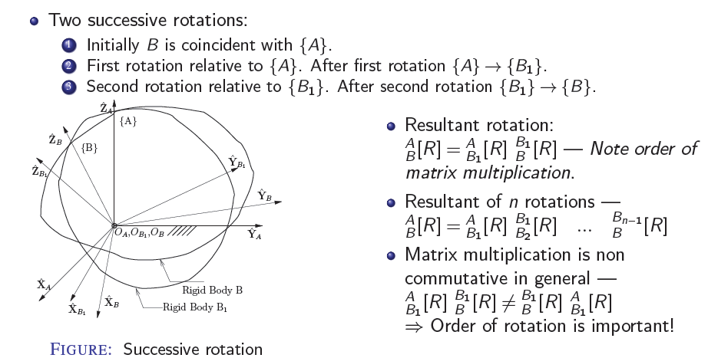
SUCCESSIVE ROTATIONS

Slide 65
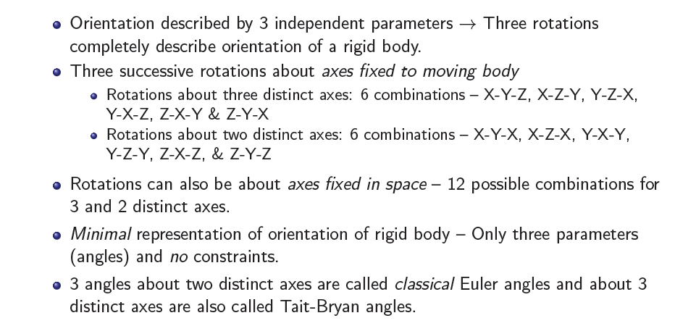
ORIENTATION – THREE ANGLES

Slide 66
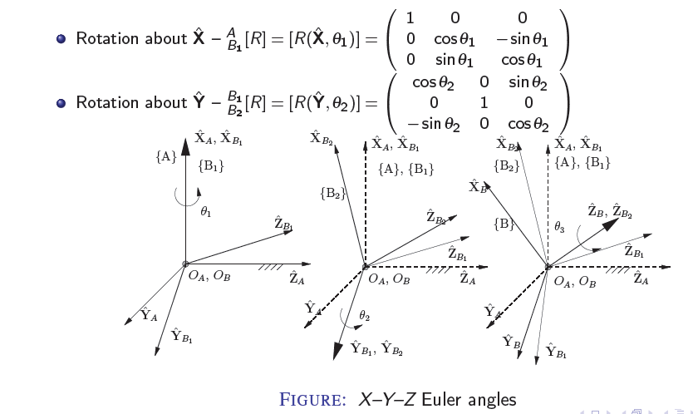
X–Y–Z EULER ANGLES

Slide 67
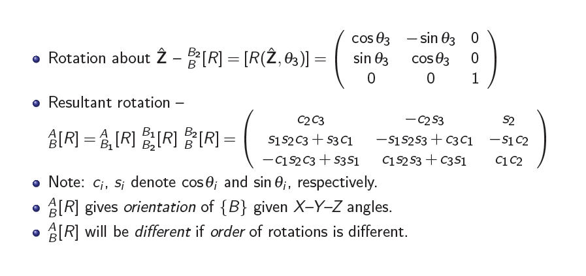
X–Y–Z EULER ANGLES

Slide 68
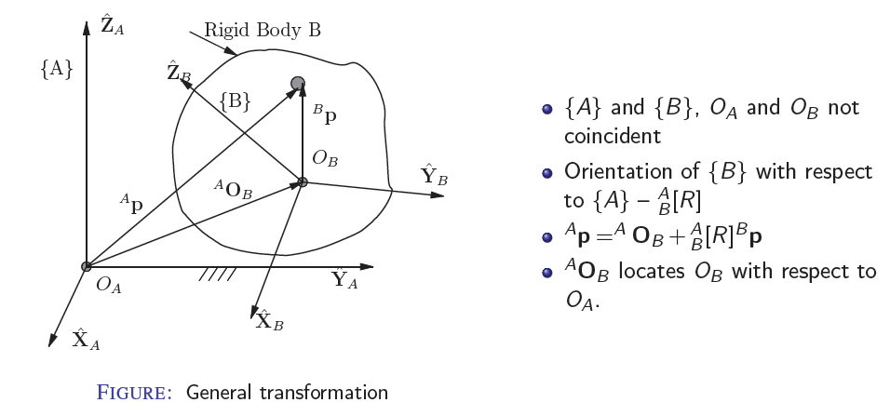
COMBINED TRANSLATION AND ORIENTATION OF A RIGID BODY

Slide 69
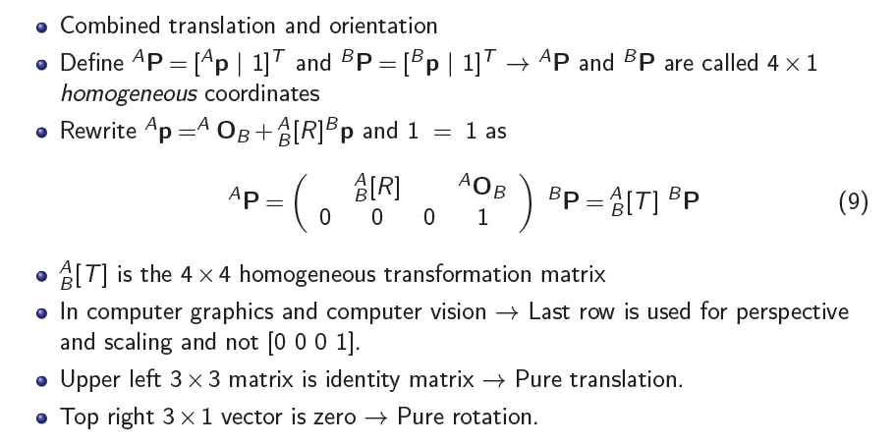
Homogeneous Transformation

Slide 70
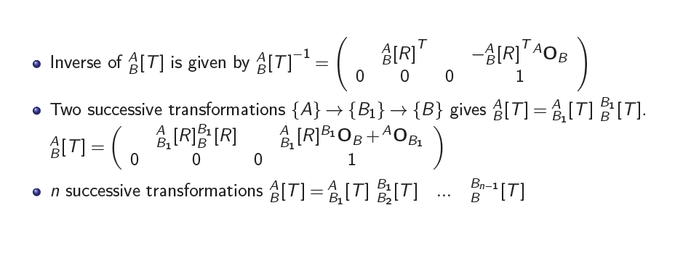
4 X 4 Transformation Matrix Properties

Slide 71
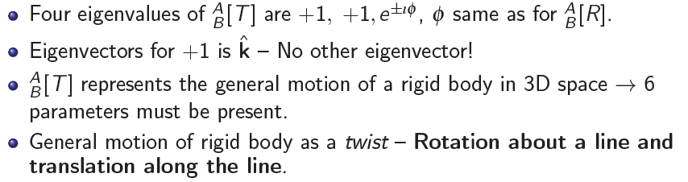
4 X 4 Transformation Matrix Properties

Slide 72
D-H Parameters

Slide 73
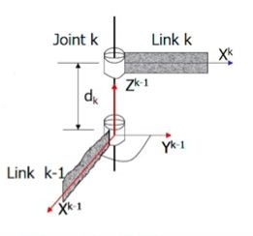
Joint Parameters
The relative Position and Orientation of two successive links can be specified by two joint parameters , Joint Angle and Joint Distance.
Joint k connects link k-1 to link k. The parameters associated with joint k are defined w.r.t. z^{k-1,} which is aligned with the axis of joint k.

Slide 74
Joint Parameters
The joint angle θ_{k} is the rotation about Z^{k-1} needed to make axis X^{k-1} parallel with axis X^{k}.
Joint distance d_{k}, is the translation along Z^{k-1} needed to make X^{k-1} intersect with axis X^{k}.
Thus joint angle is a rotation about axis of joint k, while joint distance is a translation along joint axis.
For each joint it will always be the case that one of these parameter is fixed.

Slide 75
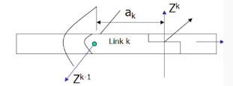
Link Parameters
The relative position and orientation of the axis of two successive joints can be specified by two link parameters, link length and link twist angle.
Link k connects joint k-1to joint k.
The parameters associated with link k are defined w.r.t. X^{k}, which is common normal between the axes of joint k-1 and k.
Link length, a_{k} is the translation along X^{k} needed to make axis Z^{k-1} intersect Z^{k}.
Twist angle α_{k} is the rotation about X^{k} needed to make axis Z^{k-1} parallel with axis Z^{k}.

Slide 76
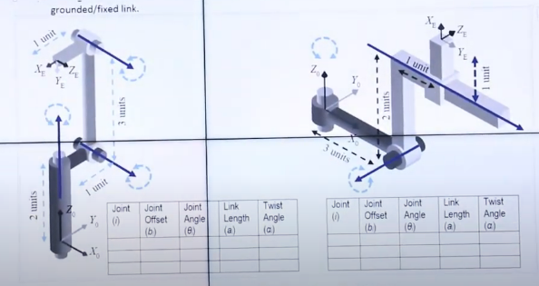
D-H Parameters

